Slide 1
Spreadsheet Model of SOFC Electrochemical Performance
Larry Chick, Jeff Stevenson and Rick Williford
August 29, 2003

Slide 2
Brief Demo of Basic Model

Slide 3
Outline
Purpose of the spreadsheet model
Strategy and assumptions
Input parameters
Calculation of IV response
  Chemistry – water gas shift
  Nernst potential
  Ohmic loss
  Effect of leaks
  Cathode overpotential – Butler-Volmer
  Anode overpotential – bulk and surface diffusion
Calculation of heat generation
Adjustable parameters – calibrating the model
Future improvements

Slide 4
Purpose
“One-dimensional” stack calculations
Stack module for systems modeling
Electrochemical algorithm to be embedded into CFD or FEA codes for “full-up” three-dimensional modeling of stacks
Provide guidance for stack component development – How can we improve performance?

Slide 5
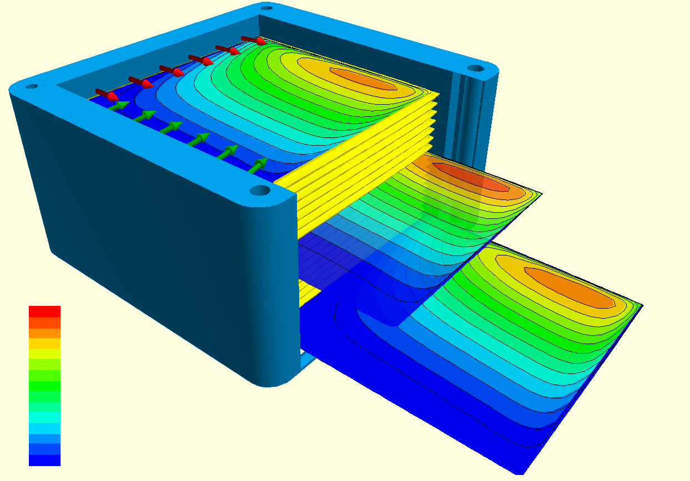
Strategy and Assumptions
Unit cell
  homogeneous temperature
  homogeneous gas compositions
air
cathode
electrolyte
anode
fuel
interconnects (not shown)

Slide 6

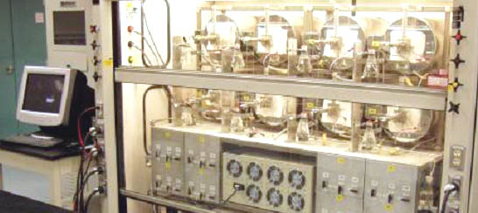
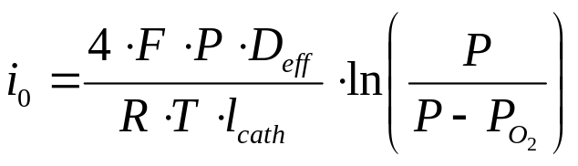
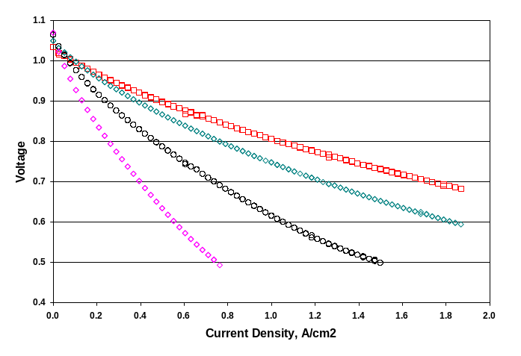
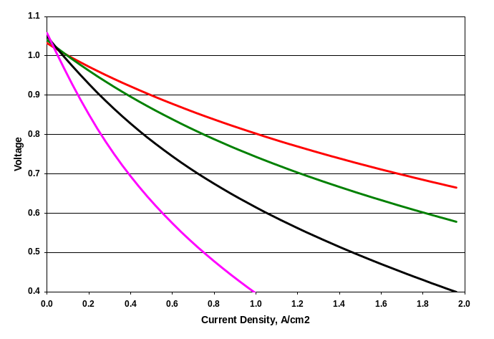
Strategy and Assumptions, cont.
Theoretically based
Empirically calibrated
button cell data for range of operating conditions
calibrated model

Slide 7
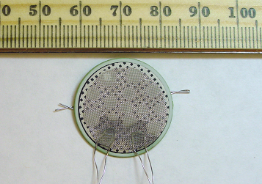
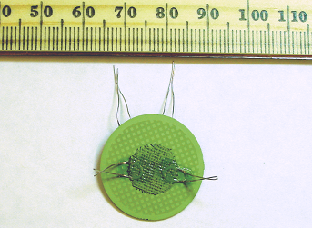
Button Cell Experimental Set-Up
~3cm² active area
P
t
M
e
s
h
V
l
e
a
d
I
l
e
a
d
P
t
G
r
i
d
P
t
c
u
r
r
e
n
t
c
o
l
l
e
c
t
o
r
T
h
e
r
m
o
-
c
o
u
p
l
e
C
a
t
h
o
d
e
C
e
r
i
a
Y
S
Z
Anode substrate
i
n
t
e
r
l
a
y
e
r
A
l
u
m
i
n
a
C
a
t
h
o
d
e
P
t
I
-
V
W
i
r
e
s
s
e
a
l
i
n
g
c
e
m
e
n
t
N
i
c
u
r
r
e
n
t
c
o
l
l
e
c
t
o
r
A
l
u
m
i
n
a
C
a
t
h
o
d
e
P
t
I
-
V
W
i
r
e
s
t
u
b
e
A
n
o
d
e
S
u
b
s
t
r
a
t
e
N
i
M
e
s
h
V
l
e
a
d
I
l
e
a
d
A
n
o
d
e
P
t
I
-
V
W
i
r
e
s

Slide 8
Starting Points for SOFC Theory:
J.W. Kim, A.V. Virkar, K.Z. Fung, K. Mehta, .SC. Singhal, J. Electrochem. Soc. 146, 69 (1999).
NQ Minh, T. Takahashi, Science and Technology of Ceramic Fuel Cells, Elsevier Publishers, Amsterdam (1995).
E.L. Cussler, Diffusion: Mass Transfer in Fluid Systems, 2nd Edition, Cambridge University Press, Cambridge, UK (1977) Chapter 3.
I. Reiss and J. Schoonman, in CRC Handbook of Solid State Electrochemistry, CRC Press, Boca Raton, 291 (1977).
Y. Jiang and A.V. Virkar, J. Electrochem. Soc. 150, 7 (2003).

Slide 9
Input Parameters
Stack materials properties and dimensions
  active area
  component thickness
  porosity
Stack operating conditions
  temperature
  fuel composition
Adjustable parameters, used in calibrating model to fit experimental data sets

Slide 10
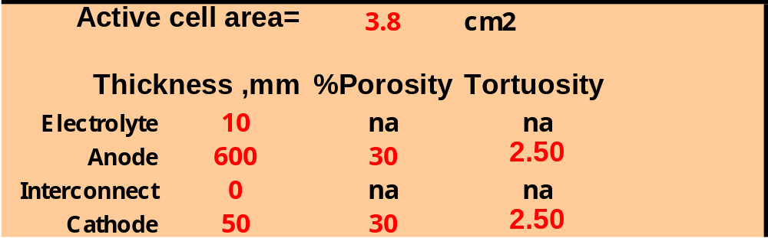
Input Parameters, Cont
Stack materials properties and dimensions
  Basic model: red font cells in the range E10-H16

Slide 11
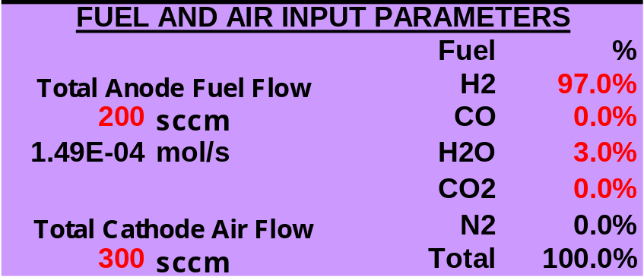
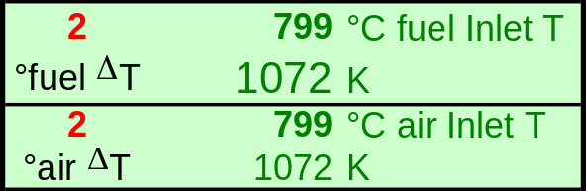

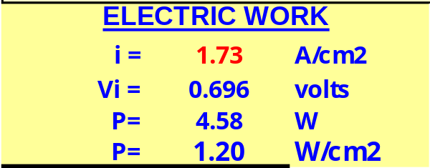
Input Parameters, Cont
Stack operating parameters
  Fuel and air parameters: B1-G9
  Stack temperatures and ΔTs: B21, B23 and G18
  Stack current density: I6

Slide 12
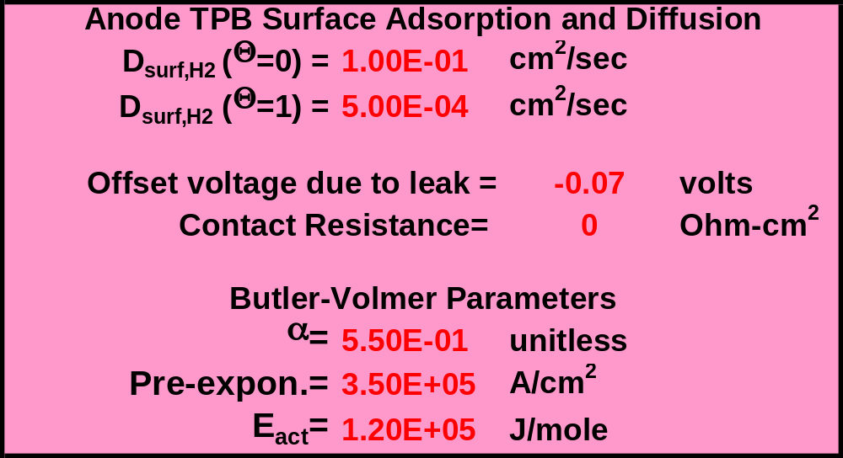
Input Parameters, Cont
Adjustable parameters
  Surface adsorption parameters: G21 and G22
  Offset voltage due to leaks: H24
  Contact resistance: H25
  Butler-Volmer parameters: G28, G29 and G30

Slide 13
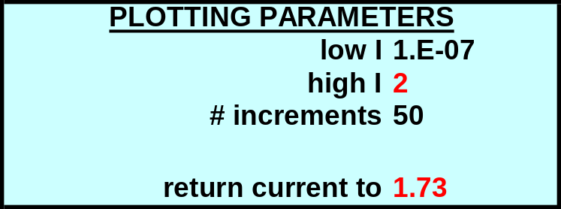

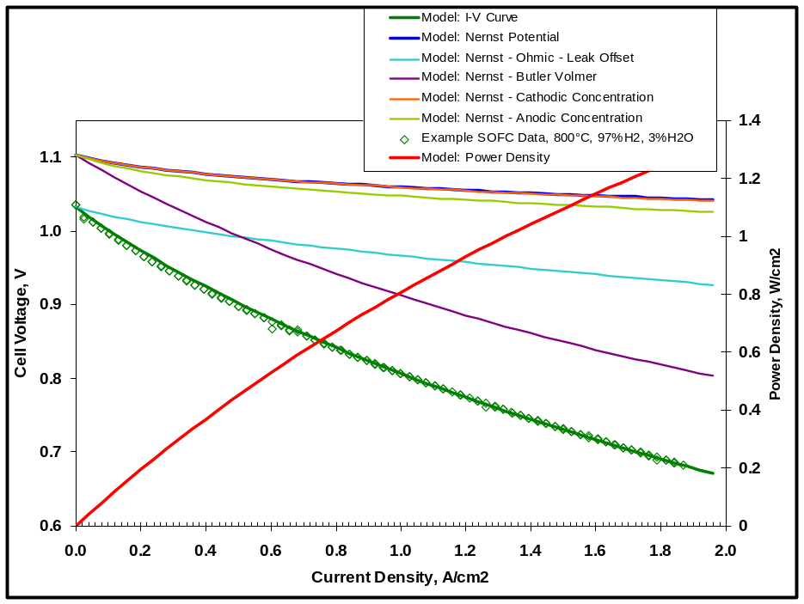
Input Parameters, Cont
Plotting Parameters: O3 and O6
Note: plots can be dragged and dropped to uncover calculation cells.

Slide 14
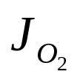
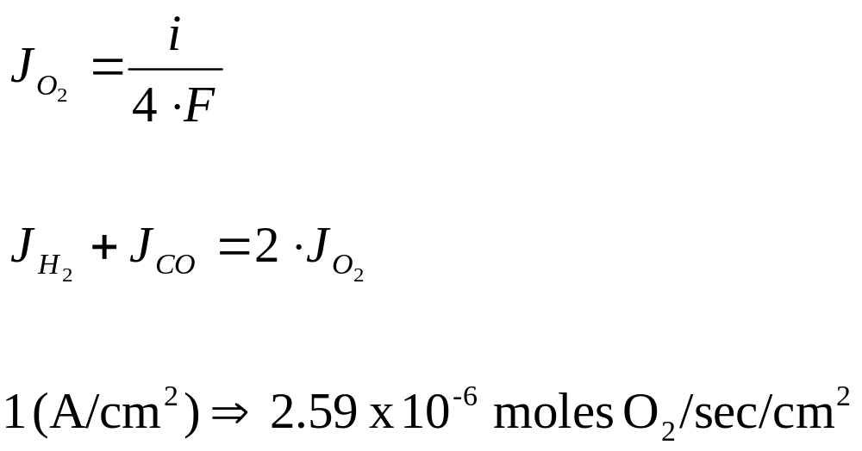
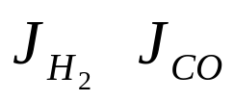
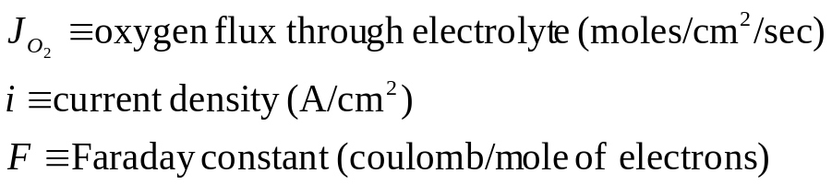
Chemical Calculations
Calculations based on current density.
Current density establishes rate of oxygen transport through electrolyte, which establishes rate of fuel consumption:

Slide 15
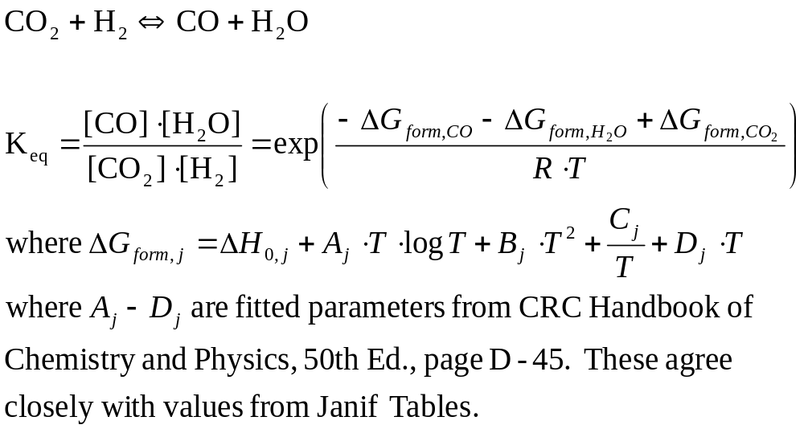
Chemical Calculations
Assume fuel gas is always in equilibrium with regard to the water-gas shift reaction:

Slide 16
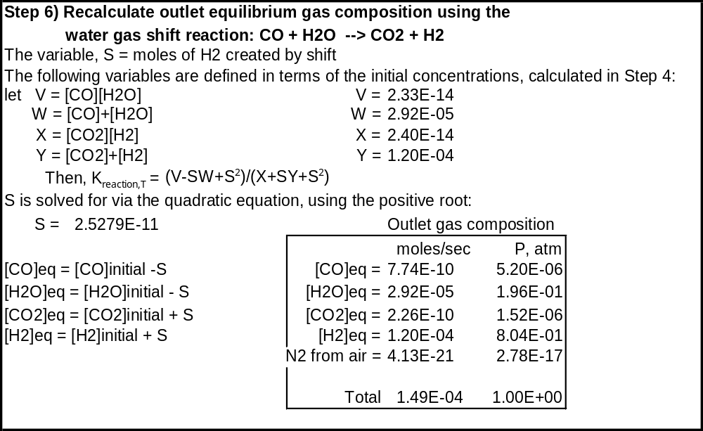
Chemical Calculations, cont.
Fuel gasses are adjusted via shift eq. after input and prior to output
Example: Basic Model, cells B89-H108

Slide 17
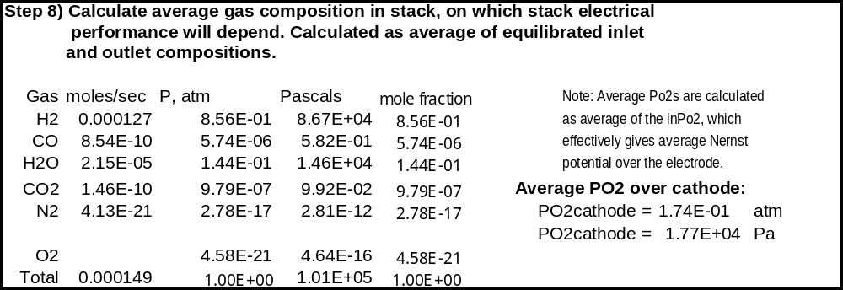
Chemical Calculations, cont.
Overpotentials are calculated based on the average of the shift-equilibrated inlet and output gas compositions.
Example: Basic Model, cells B112-J124

Slide 18
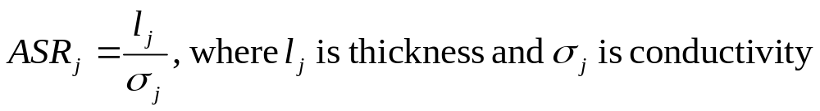
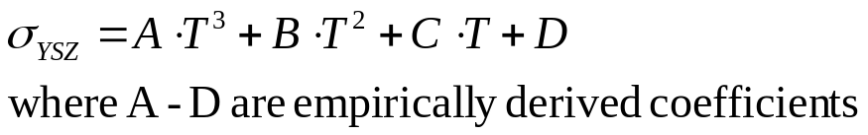
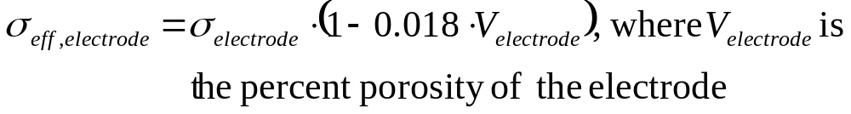
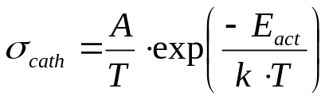
Ohmic Losses
Resistive loss of cell components
  Area specific resistance (ASR):
  Voltage loss due to ohmic resistance:
  electrolyte (considerable resistance)
  electrodes (relatively small resistance)

Slide 19
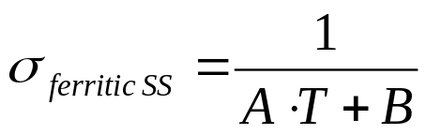

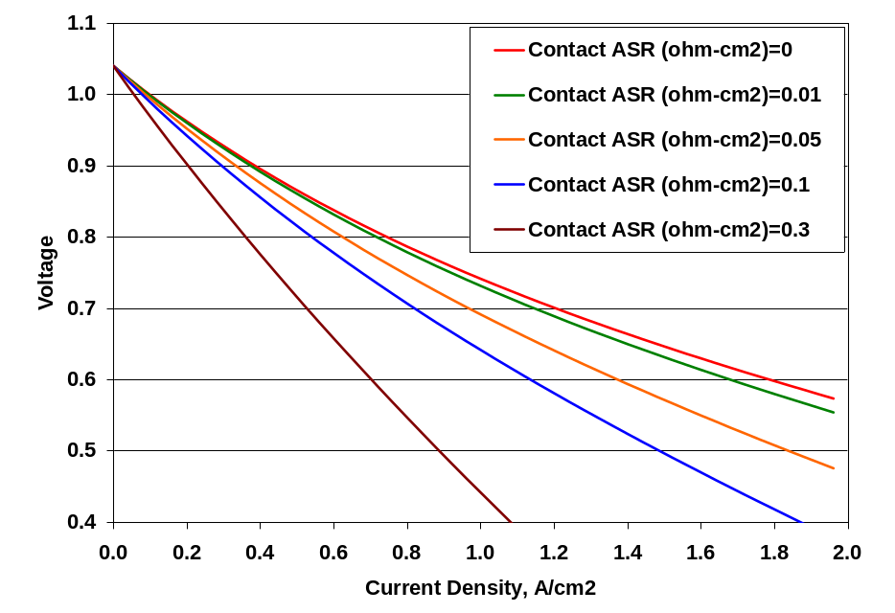
Ohmic Losses, cont.
Resistive loss of interconnect components and interfaces
  conductivity of stainless steel
  additional ohmic resistance, such as contact resistance due to formation of oxide scale

Slide 20
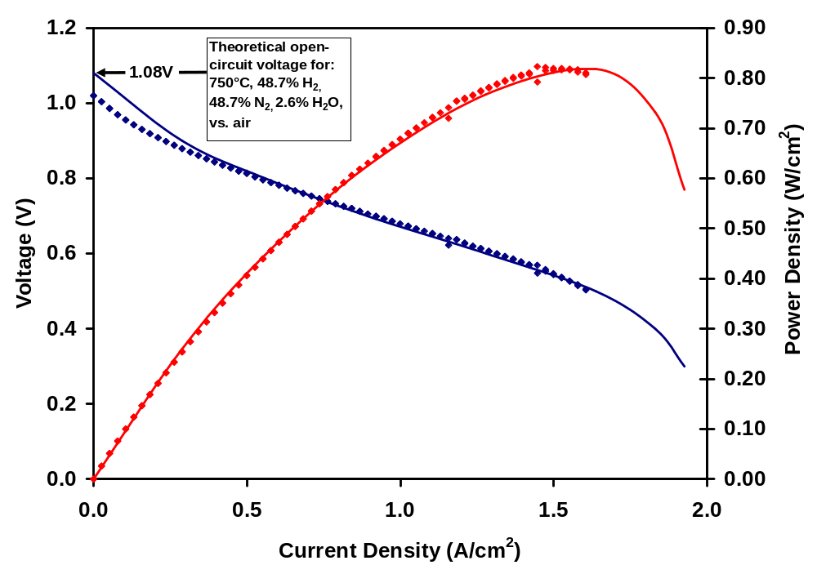
Effect of Leak on I-V Curve
Two cells were tested, one a 2.5cm button cell, known to have a small leak from anode to cathode, through porous ceramic seal (filled diamonds).
The other, a 7cm x 7cm cell with gas-tight glass seal (lines).
Cells had identical materials, processing, and operating conditions.
Comparison of I-V curves shows that the effect of the leak is “washed out” as the current increases.

Slide 21
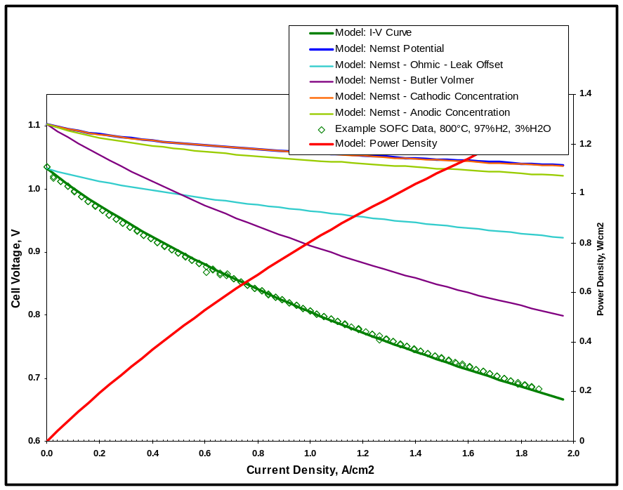
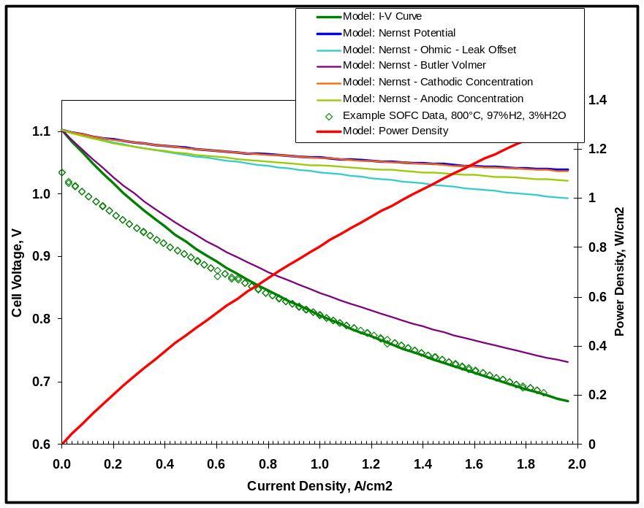
Effect of Leak on I-V Curve
Basic model subtracts constant voltage at all currents to compensate for leak effect.
Based on recent data, recommend assuming effect of leak is overcome as current increases.

Slide 22
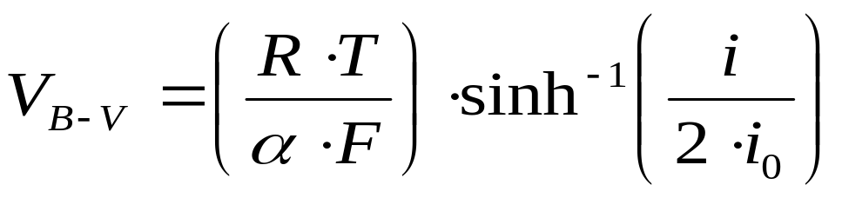
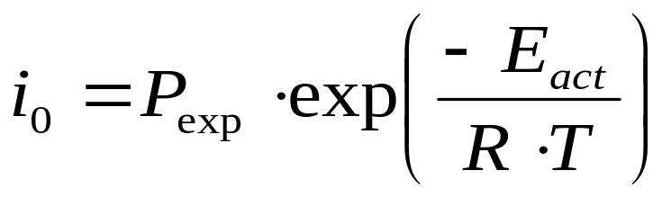
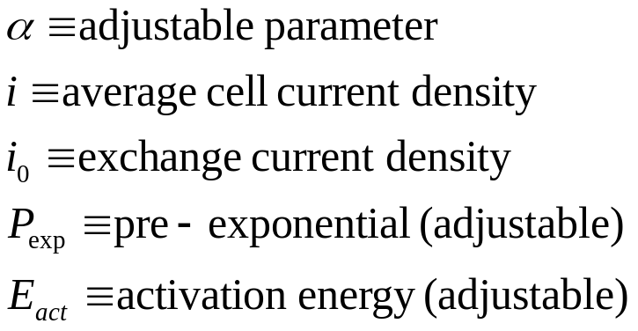
Butler-Volmer Approximation
Electrode charge-transfer overpotential
Combined for both electrodes
Three adjustable parameters for calibration

Slide 23
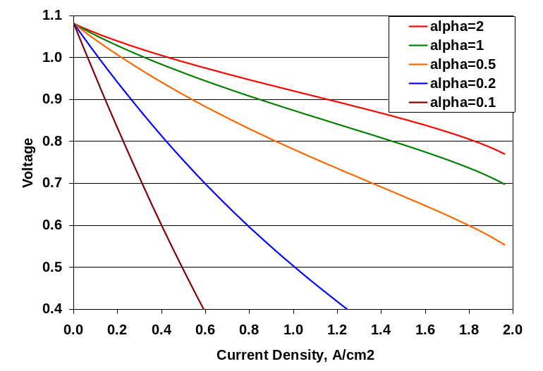
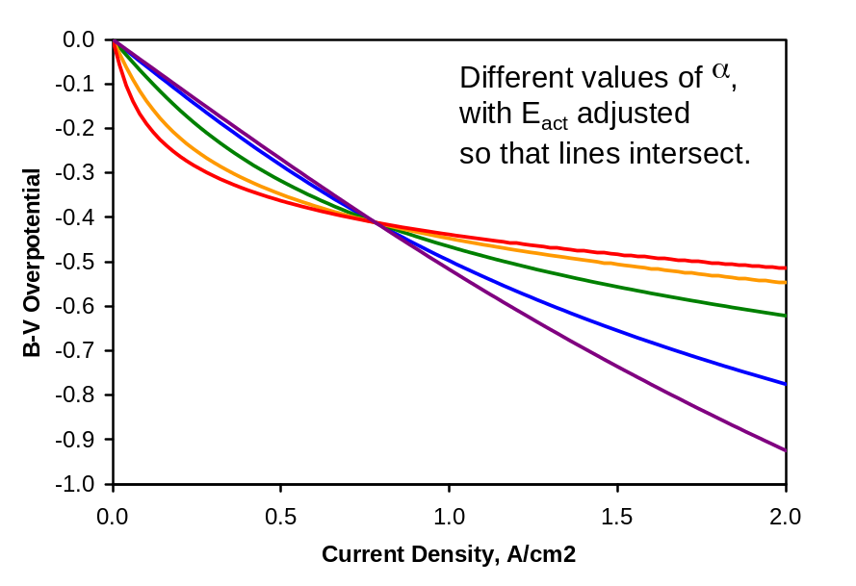
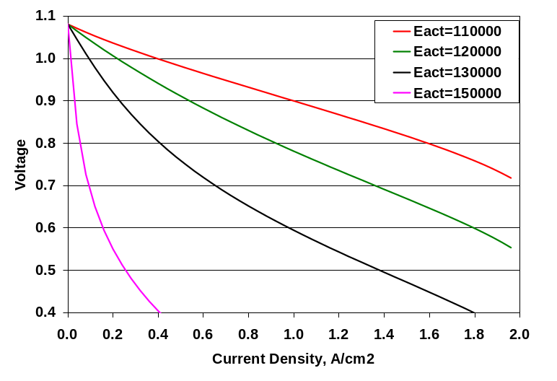
Effects of adjusting Butler-Volmer Parameters
Slope, curvature and temperature dependence

Slide 24
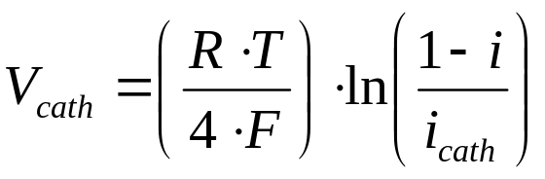
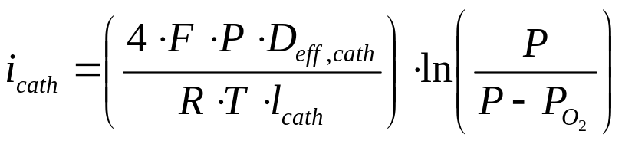
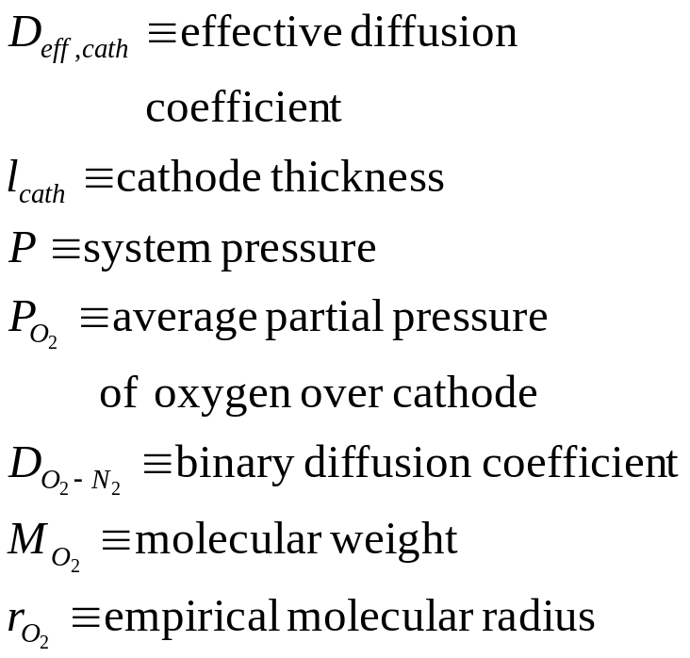
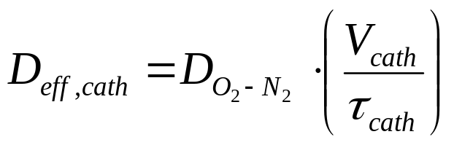
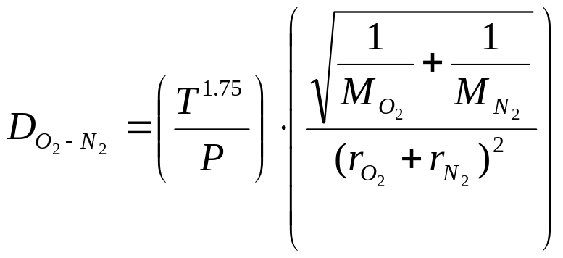
Cathode Diffusion Loss
Loss due to depletion of O₂ at the cathode-electrolyte interface
No adjustable parameters

Slide 25
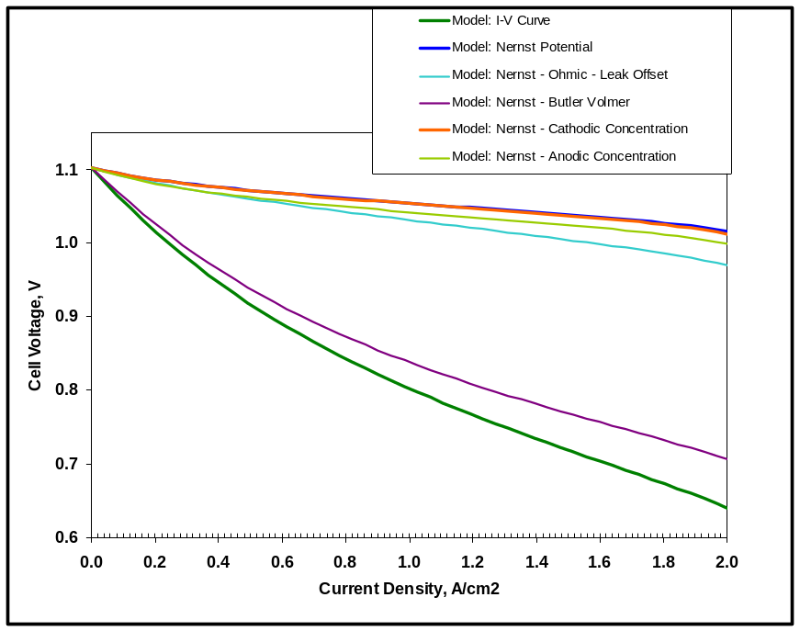
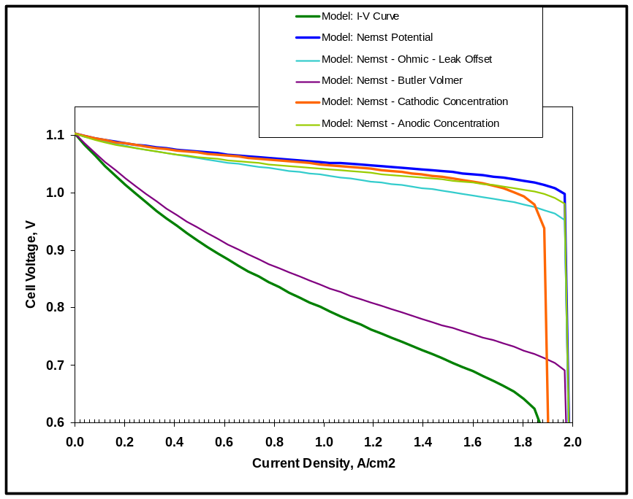
Cathode Diffusion Loss, Cont.
No significant overpotential until oxygen is almost completely gone.
90% O₂ utilized at 2 A/cm²
50 μm cathode, 30% porosity, τ=2.5
No discernible effect
100% O₂ utilized at 2 A/cm²
50 μm cathode, 30% porosity, τ=15
Significant effect at high currents.

Slide 26
Anode Overpotential
Outline
• Parallel reactions (H₂ & CO), solve by electrical
circuit analogy
• Limiting currents for concentration polarization
• Products - classical pore diffusion model
• Reactants - surface adsorption/diffusion model

Slide 27
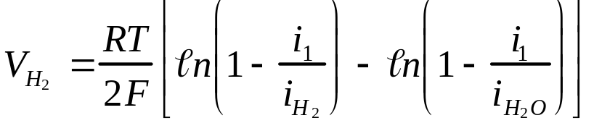
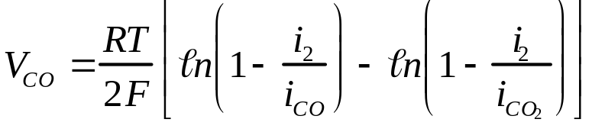
Anode Overpotential
Two simultaneous reactions
  H₂+1/2O₂->H₂O and CO+ 1/2O₂->CO₂
Solve by electrical circuit analogy
i_{total}
i_{1,} v₁
i_{2,} v₂
Kirchoff’s Laws: i₁+i₂=i_{total}, v₁=v₂
(Cells M106-U131)

Slide 28
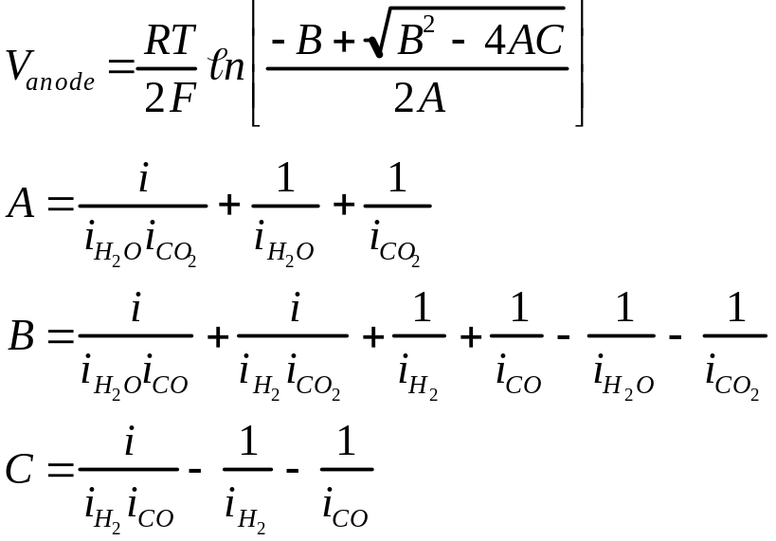
Anode Overpotential
Solve by electrical circuit analogy
Kirchoff’s Laws: i₁+i₂=i_{total}, v₁=v₂
The familiar quadratic solution
(Cells M106-U131)

Slide 29
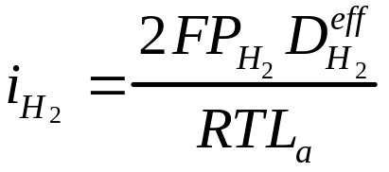
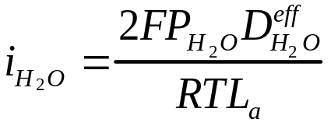
Anode Overpotential
Each branch of circuit treats reactants (H₂,CO) and products (H₂O,CO₂), eg,
Each term contains a ‘limiting current’ (i_{H2}, i_{H2O} )
  Defined by partial pressure (P_{H2}), effective diffusivity (D^{eff}), anode thickness (L_{a})
(Cells M106-U131)

Slide 30
Anode Overpotential
The limiting currents are derived for open circuit conditions, and assume that the reactant concentrations approach zero in the gas immediately above the reactive sites.
This may not be true, but serves as a working approximation to investigate the importance of other mechanisms in the context of previous models, thus maintaining a connection (benchmark) to prior models.

Slide 31
Anode Overpotential
Limiting current differs for reactants and products
H₂ controlled by adsorption & surface diffusion to TPB, H₂O by bulk diffusion through pores
The difference is how you treat the effective diffusivity
Reactant
Product
(Cells M106-U131)

Slide 32
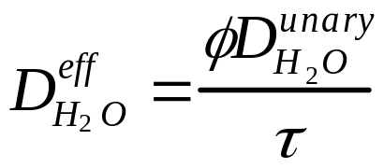
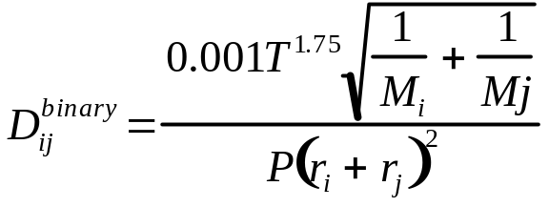

Anode Overpotential
• Product (H₂O) limiting current controlled by
bulk diffusion through pores (a classical model)
• φ=porosity, τ=tortuosity, x=mole fraction,
P=total pressure, M=molec. wt., r=molec. radius
(Cells W63-AD88)

Slide 33
Anode Overpotential
Concentration polarization due to limited reactant (H₂) supply rates may be caused by surface adsorption and diffusion mechanisms very near the TPBs, rather than by bulk diffusion mechanisms through the porous ceramic.
The following is a proposed model currently under development.

Slide 34


Question
Is concentration polarization really caused by
high bulk diffusion resistance (tortuosity)?
Modeling
problems

Slide 35
Tortuosity is...
Apparent diffusion path length / anode thickness.
A measure of bulk diffusion resistance.
An empiricism describing all we don’t know about the microstructure of the pore network.

Slide 36
This is Important Because...
The maximum current (or power envelope) is not adequately predicted by SOFC models, unless…
Anode tortuosity τ is assumed to be 10 - 17, which disagrees with historical data (τ = 2 - 6), and...
Is misleading…smaller thickness or higher porosity compromises structural integrity.
Does a high bulk diffusion resistance really exist?

Slide 37


Anode Tortuosity Experiments
Wicke-Kallenbach experiments
Maxwell-Stefan problem for
counter-diffusing gases:

Slide 38

Anode Tortuosity
τ = 2.5-3.5 for modern porous ceramic anodes
Anode diffusion resistance is not in the bulk material.

Slide 39
Possible Explanations
Non-ideal gas behavior?
  Minimal counter-diffusion effect in τ vs φ plot.
  Two analysis methods showed negligible effect.
Knudsen effects at anode/electrolyte interface?
  Microscopy shows no change in pore structure.
Competitive adsorption and surface diffusion?
  A possible explanation.

Slide 40

Competitive Adsorption &
Surface Diffusion at TPBs
Electrolyte
Porous Anode
Diffusion Circuit
Bulk
Low demand
or high H₂
Surface
Bulk
Surface
High demand
or low H₂

Slide 41

Proposed H₂ Mechanism
• TPB active sites are occupied by H₂O at high T.
• Hydrogen adsorbs on regions adjacent to TPBs,
• diffuses along the surface to the TPBs,
• reacts at TPBs to form new H₂O, old H₂O desorbs.

Slide 42


Competitive Adsorption near TPBs
Langmuir multi-gas isotherm
Q_{i} = Adsorption activation energy
θ_{i}=surface coverage (0<θ<1)
b_{i}=Langmuir parameter for species i
P_{i}=partial pressure
N_{A}=Avogadro’s number
A_{i}=area of molecule on surface
τ₀=vibrational period (10⁻¹³/sec)
M_{i}=molecular weight
(Cells W90-AH104)

Slide 43


Surface Diffusion to TPB Active Sites
Transition from bulk to surface diffusion (Vignes, 1966)
D_{eff} = (D_{bulk})^{Θ} (D_{surf})^{1-Θ}
A linear correlation between the diffusion exponents
(Cells W90-AH104)

Slide 44

Surface Diffusivity
Depends on coverage (θ_{ι})
• For hydrogen on Ni at ~1023K
D_{s,H,0}~0.1 cm²/sec at zero coverage
D_{s,H,1}~5x10⁻⁴ cm²/sec at full coverage
1/(1-θ_{H})= thermodynamic factor
(Cells W90-AH104)

Slide 45

Fit Q & D_{s} to Experimental Data
Results for H₂, PNNL SOFC Spread Sheet Model, 2002

Slide 46
Fitted parameters agree with independent data for H₂ on Ni @ 750C
Parameter Fit Data
Q_{H2} eV/molecule 0.425 0.2 - 0.4
D_{s,H2} cm²/sec 5.6x10⁻⁴ 4.8-6.8x10⁻⁴

Slide 47
Anode Overpotential Summary
• Anode diffusion resistance
originates at the anode/electrolyte interface,
not in the bulk material.
• Anodic concentration polarization may be caused by competitive adsorption and
surface diffusion near TPBs.
• Fitted Q_{H2} and D_{s} for H₂ agree with literature, so the
model’s physical foundations appear credible.
• Work is in progress to refine and extend the model.

Slide 48


Effect of adjusting Surface Diffusion Parameters
Position of limiting current “tail”.

Slide 49

Enthalpy Calculations – Oxidation of Fuel
Enthalpy changes related to fuel oxidation are calculated using standard "textbook" thermodynamics, taking advantage of the fact that enthalpy is a state function. Fuel gas is “virtually” cooled to RT, oxidized at RT, then heated to outlet temperature. (Cells C137-P195)
The starting point for the calculations is the fuel gas composition as equilibrated at the inlet temperature expressed in flow rate for each species (Cells C13-C17).
Step 1) The anode inlet gas mixture is cooled down to room temperature.
  e.g: H₂ (T_{inlet}) → H₂ (298 K)
  Similar calculations for other species (CO, H₂O, CO₂, N₂)
  ΔH_{cooling} = ∑ ΔH_{i} i = H₂, CO, H₂O, CO₂, N₂

Slide 50
Enthalpy Calculations – Oxidation of Fuel
Step 2) The appropriate amounts of H₂ and CO (based on inlet and outlet fuel concentrations) are oxidized at room temperature using room temperature enthalpies of formation for products and reactants.
  CO + 1/2 O₂ → CO₂ ΔH₁ = ΔH_{f} (CO₂) - ΔH_{f} (CO)
  H₂ + 1/2 O₂ → H₂O ΔH₂ = ΔH_{f} (H₂O)
ΔH_{ox} = ΔH₁ + ΔH₂

Slide 51

Enthalpy Calculations – Oxidation of Fuel
Step 3) The anode outlet gas mixture is heated to the outlet temperature.
  e.g: H₂ (298 K) → H₂ (T_{outlet})
  Similar calculations for other species (CO, H₂O, CO₂, N₂)
  ΔH_{heating} = ∑ ΔH_{i} i = H₂, CO, H₂O, CO₂, N₂
Step 4) The net enthalpy for fuel oxidation is obtained by summing the enthalpies from Steps 1-3:
  ΔH_{net} = ΔH_{cooling} + ΔH_{ox}+ ΔH_{heating}

Slide 52
Enthalpy Calculations – Oxidation of Fuel
Step 5) The electrical power produced by the stack (as calculated by the model, see Cell I8) is then subtracted from the calculated enthalpy (Cell G175) to yield the net sensible heat produced by the cell/stack:
  Q_{oxid} = ΔH_{net} - Work_{elect}

Slide 53

Enthalpy Calculations – Cathode Air
Changes in enthalpy associated with the removal of heat by cathode air as it passes through the stack are calculated using the same methodology as for fuel oxidation.
Starting point for calculation is inlet cathode air flow rate and temperature; oxygen removed via electrolyte membrane is subtracted from oxygen calculation:
  N₂ (T_{inlet}) → N₂ (T_{outlet})
  Similar calculation for oxygen
Q_{cath} = ΔH_{cath} = ΔH_{N2} + ΔH_{O2}

Slide 54
Enthalpy Calculations – Final Answer
The net sensible heat generated by the cell/stack is obtained by adding together the enthalpy of fuel oxidation and the enthalpy of cathode air heating.
Q_{net} = Q_{oxid} + Q_{cath}
Result is shown in Cell K6 (with incorrect units – should be W instead of W/cm² !)
Divide by active area (Cell G10) to convert to W/cm²
Note: The thermodynamic values for the various reactants and products in the preceding calculations were taken from Appendix C of Stoichiometry and Thermodynamics of Metallurgical Processes by Y.K.Rao, Cambridge, 1985

Slide 55
Second Demo and Discussion of Basic Model
Overpotential plotter.
Eliminate leak correction.
Adjust B-V parameters.

Slide 56
Features of Advanced Model
Enhanced plotting macro for calibration
Temperature-dependent Butler-Volmer parameters

Slide 57
Demo and Discussion of Advanced Model
Enhanced plotting macro
General Seeker macro

Slide 58
Future Improvements
Leaks ignored.
Additional inert gasses: He, Ar as well as N2.
Improved treatment of electrode diffusion.
Temperature dependent contact resistance.
Sheet resistance of cathode.

